Slide 1
Web application to combat the case of Bio war and Disease Outbreak in India.
G.SRIRAM, College of Engineering Guindy
M.HARI HARA GANESH, College of Engineering Guindy
R.BALAJI , College of Engineering Guindy
Notes:
Esri Corporate Template-Dark v3.2
16:9 version – March 19, 2015
For more templates, sample files, and icons, see https://compass.esri.com/resources/presentations/Pages/Main.aspx
To add footer text in Windows
On the Home tab, under Insert, click Text, and then click Header and Footer.
Click the Slide tab, select the Footer check box, and then type the footer text that you want.
Click either Apply or Apply to All.
To add footer text on a Mac
On the View menu, select Header and Footer.
Select the Footer check box and then type the footer text that you want.
Click either Apply or Apply to All.
If footers don't appear on the slides
If footers don't appear on title slides, in the Header and Footer dialog box make sure the Don't show on title slide check box is not selected.
If the footers are missing from other slides, the placeholders for these items might have been removed from specific slide layouts or the slide master.

Slide 2
PROBLEM STATEMENT
India is a country having very moderate medical resources coupled with low levels of sanitation.
This makes India prone to disease outbreak and highly vulnerable to Bio war in case any external agency uses this as a medium to target India.
CASE HISTORIES:
The current scenario of dengue outbreak in Chennai shows how the city is ill-equipped to face the disease.
The case of Chikungunya outbreak in India in 2005 was also a case of high volatility and mismanagement.

Slide 3
SOLUTION CONCEPT
Hospitals have to register and a reference number is generated for them
Doctors have to login using the hospital credentials once the disease has been detected
A form has to be filled by the doctor which explains the disease and precautions to be taken
The location of the hospital is marked on a web map and the doctor input is generated as a pop up on the map.
Number of additional functionalities like buffer analysis and view-shed analysis can be used by doctors as well as the public.
A dedicated community section is present for the discussion of the issues prevalent and for authentic information.

Slide 4
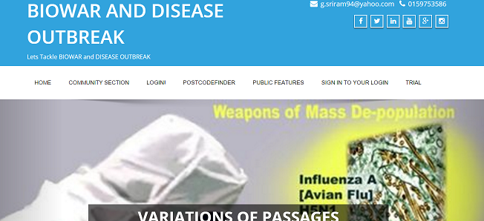
APPLICATION SNAPSHOTS

Slide 5
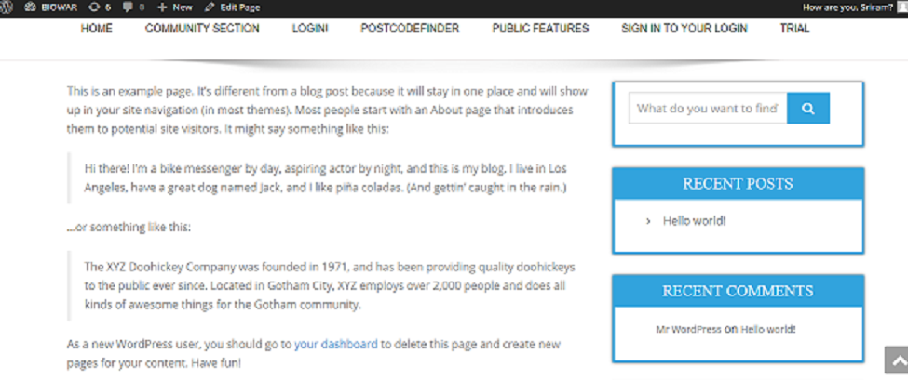

Slide 6
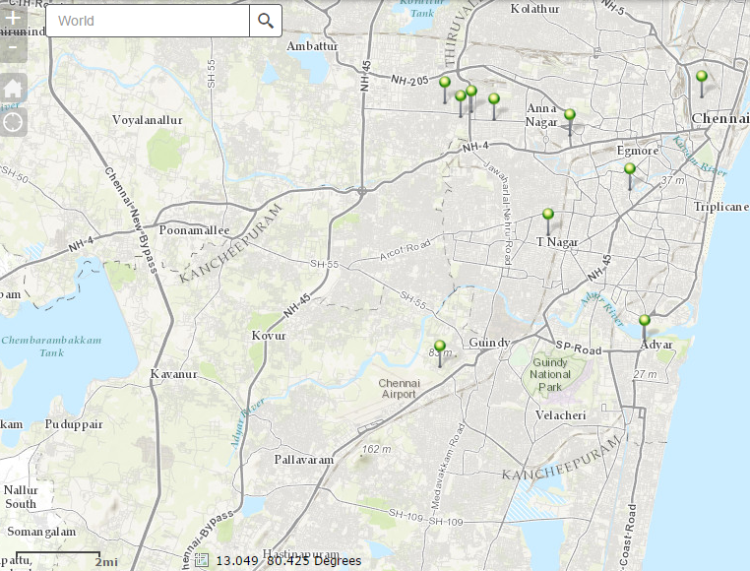

Slide 7
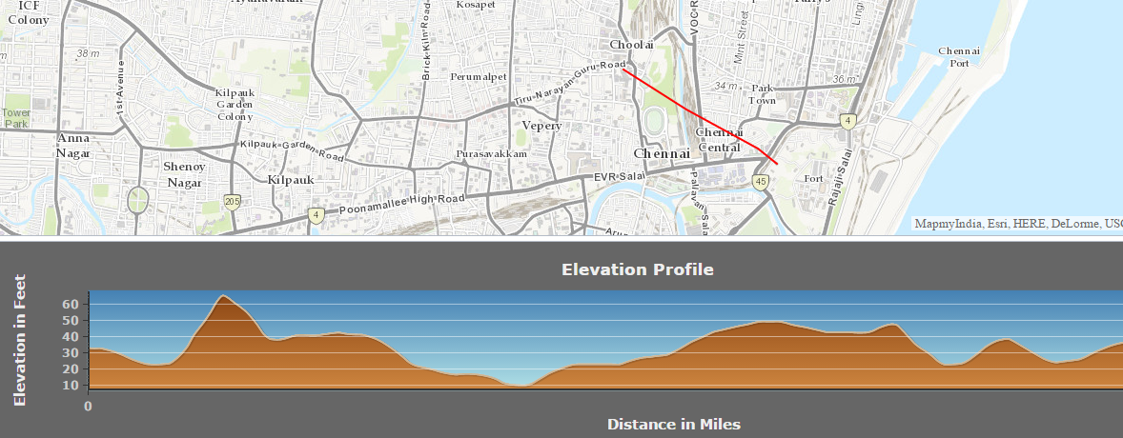

Slide 8
LIVE DEMO

Slide 9
CITIZEN USEFULNESS
Localisation of the problem
Availability of authentic information
Vibrant community participation
Preparedness for the disaster.
Visualisation in the form of maps

Slide 10
SCALABILITY
The app can be extended to the mobile platform.
A separate section can be made for the government to make understand the scenario and take measures.
A decision support system can be integrated into the platform for taking critical decisions to handle the disaster.
A separate provision can be kept for the input of resources available in each hospital to tackle any given disease.

Slide 11
ANY QUERIES?

Slide 12
THANK YOU

